Slide 1
Employee Data Analysis using Excel
STUDENT NAME :R.SOWMIYA
REGISTER NO :2213391036048
NAAN MUDHALVAN ID:3018B33FD7B0C6187AF4D722ABBFD7D7
DEPARTMENT :B.COM( GENERAL)
COLLEGE : QUEEN MARY’S COLLEGE

Slide 2
PROJECT TITLE
Employee Performance Analysis using Excel

Slide 3


AGENDA
Problem Statement
Project Overview
End Users
Our Solution and Proposition
Dataset Description
Modelling Approach
Results and Discussion
Conclusion
3/21/2024 Annual Review

Slide 4

PROBLEM STATEMENT
"Organizations struggle to efficiently track, analyze, and visualize employee performance data, making it difficult to identify areas for improvement, set realistic goals, and make data-driven decisions. How can we utilize Excel to create a comprehensive and user-friendly employee performance analysis system, enabling HR and management to optimize talent development, boost productivity, and drive business growth?"

Slide 5

PROJECT OVERVIEW
.
It is an project about the employee performance and make them effective work though analysis their works and make appreciation and boosting their performance.It is done by the following 1.Collect and store employee performance data. 2.Analyze and calculate performance metrics 3. Visualize performance trends and insights through charts and graphs 4. Identify areas for improvement and provide recommendations.

Slide 6
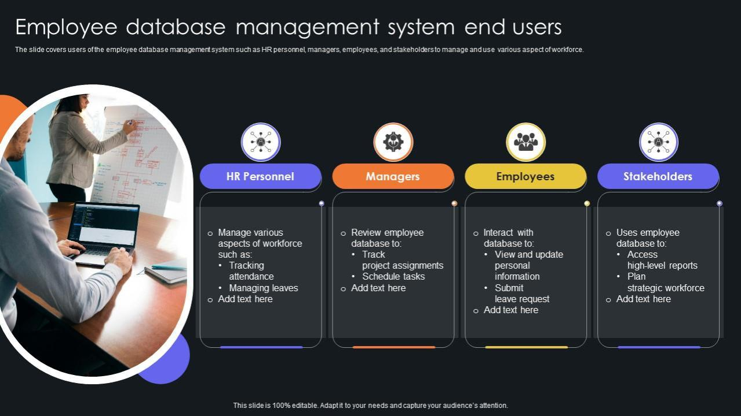

WHO ARE THE END USERS?

Slide 7

OUR SOLUTION AND ITS VALUE PROPOSITION Conditional formatting: missing Filter: remove Formula: performance Pivot: summary Graph: data visualization

Slide 8
Dataset Description
Data collection :kaggle
Department: Name
Fixed term : Number
Gender:Male, Female
26- Features
9-features
Employee type :Fixed term ,permanent, temporary

Slide 9

THE "WOW" IN OUR SOLUTION
In this project,
There are two sheet the first sheet represent the gross total performanceof both male and female and
Second sheet represent the
Indivudual performance of male and female
3/21/2024 Annual Review
9

Slide 10
MODELLING
DATA COLLECTION: 1) DOWNLOADED FROM EDUNET DASHBOARD. 2) COLLECTED EMPLOYEE PERFORMANCE SCORE. FEATURE COLLECTION: 1) IDENTIFIED PERFORMANCE LEVEL 2) TAKEN BLANKS COLUMN PERFORMANCE LEVEL: 1) IDENTIFIED PERFORMANCE SCORE USING FORMULA 2) IT IS DEFINED BY THE PIVOT TABLE SUMMARY: 1)DOWNLOADED THE EMPLOYEE DATASET FROM DASHBOARD AND DELETED THE BLANK COLUMNS. 2)CREATED PERFORMANCE LEVEL BY USING THE FORMULA. 3)AND ALSO DEFINED THEM BY PIVOT TABLE.
10

Slide 11
RESULTS
11

Slide 12
Result

Slide 13

Conclusion In conclusion, the Employee Performance Analysis System using Excel is a powerful tool for organizations to track, analyze, and improve employee performance. By leveraging Excel's capabilities for data analysis, visualization, and conditional formatting, this system provides a comprehensive solution.

